Slide 1
Synapse vs Fabric
Heidi Hasting
Martin Catherall

Slide 2
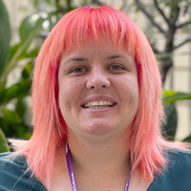
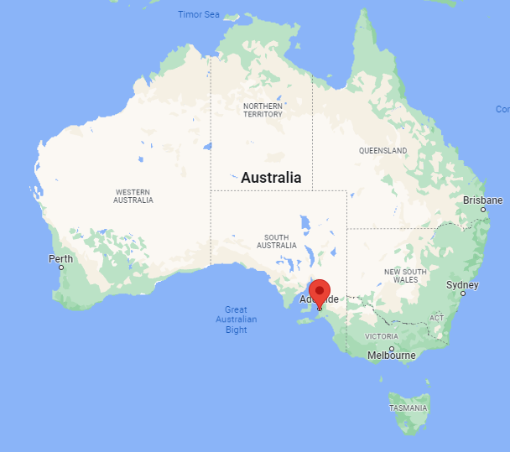
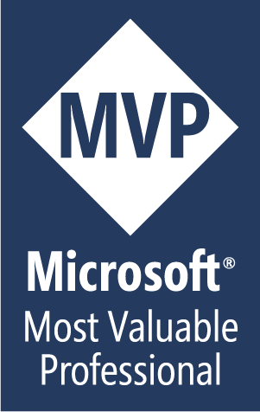
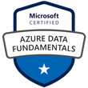
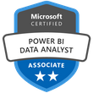
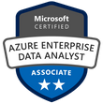


Heidi Hasting
Business Intelligence Professional formerly software developer.
Over 10 years experience in Microsoft products
Data Analytics Consultant
ALM/DLM enthusiast and Azure DevOps Fan
Regular attendee at tech events
@HeidiHasting
www.heidihasting.com

Slide 3

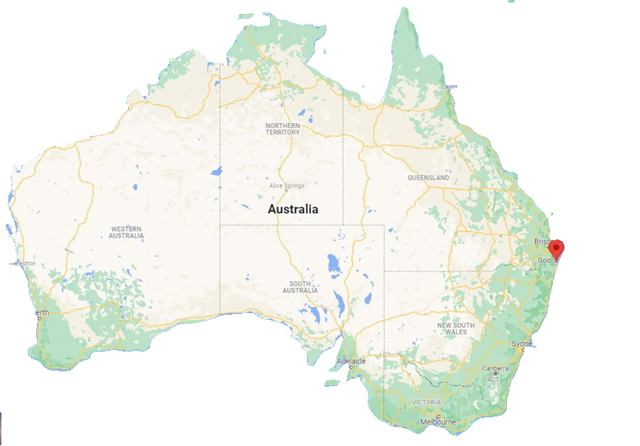

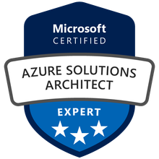
Martin Catherall
XXXX
XXX
Data Analytics Consultant
XXXX
XXXX
@MartyCatherall
www.MartinCatherall.com

Slide 4
Agenda
Part 1
Synapse demo
Fabric demo
Small interval
Part 2
Explore
Discussion / Q&A
Notes:
This 100-minute session is co-presented and will showcase Microsoft cloud-based analytics components that can be used in solutions that span the entire data lifecycle, from source system ingestion to visualization of data in reports and dashboards. The first part of this session will walk through the architectural decisions that were made to provide a complete solution based on Platform-as-a-Service components, before showcasing full implementation steps and providing attendees with reusable templates that can be used to recreate the demonstrated system. We’ll consider components such as Data Factory, Azure SQL Databases, Synapse Analytics, SQL Reporting Services and Power BI. Once the solution has been completed, we’ll look to migrate the solution to Microsoft Fabric. We’ll consider what can be moved easily, what may need to be recreated, and what, if anything, can be omitted from the Fabric solutions. We’ll consider components such as Lakehouse, including shortcuts, notebooks and Power BI using direct lake. Finally, we’ll evaluate the merits of each solution in terms of performance, maintainability, and cost. We’ll take a critical look at both solutions and evaluate what worked well in each solution and what improvements we could have made. The scenario is based on several real-world situations that the presenters have encountered in their long and varied careers as Microsoft Data Analytics Consultants. This will be a demo heavy session of both Synapse and Fabric.

Slide 5
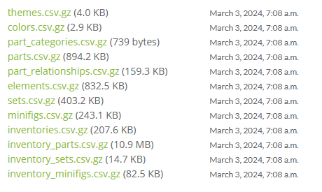
Source Data
https://rebrickable.com/downloads/

Slide 6
Overview
Source
ETL
Storage
Transform
Visualise

Slide 7
Part 1
Heidi Hasting
Martin Catherall

Slide 8
DEMO
Synapse

Slide 9
DEMO
Fabric

Slide 10
Part 2
Heidi Hasting
Martin Catherall

Slide 11
Discussion
Storage: OneLake Explorer / Storage Explorer
Migration
Model: Power BI Desktop vs Fabric (in browser)
Ingestion
Fabric Lakehouse / Warehouse
Transformation: Notebooks / Pipelines
File Format: Delta Parquet
Database Format: SQL Serverless & SQL Dedicated
Fabric shortcuts
Security
Governance
Performance
Maintainability: Cost & CI/CD

Slide 12
Questions

Slide 13

We have safely arrived at our destination.
On behalf of the entire crew, we’d like to thank you for flying with us today. We hope you had a pleasant journey, and we look forward to seeing you again soon.
Thank you and have a great day

Slide 14
Synapse
Heidi Hasting
Martin Catherall

Slide 15
Resource Group
Heidi Hasting
Martin Catherall

Slide 16
Key Vault
Heidi Hasting
Martin Catherall

Slide 17
Storage Account
Heidi Hasting
Martin Catherall

Slide 18
Synapse Workspace
Heidi Hasting
Martin Catherall

Slide 19
Key Vault Secret Management
Heidi Hasting
Martin Catherall

Slide 20
Git Integration
Heidi Hasting
Martin Catherall

Slide 21
Linked Services
Heidi Hasting
Martin Catherall

Slide 22
Synapse Pipelines
Heidi Hasting
Martin Catherall

Slide 23
External Tables
Heidi Hasting
Martin Catherall

Slide 24
Power BI
Heidi Hasting
Martin Catherall

Slide 25
Synapse The End
Heidi Hasting
Martin Catherall

Slide 32
















